Slide 1
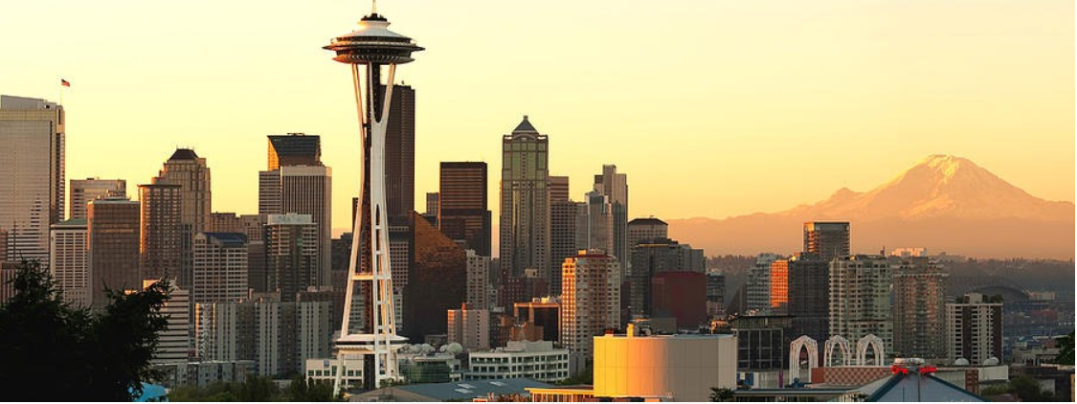
AMAZON Stock Analysis

Slide 2

Contents
Stock performance history
Exploratory data analysis
Data pre-processing
Candidate models
Strategies
Strategy performance evaluation
Conclusion

Slide 3
History of Stock price
If you bought $14,000 worth of amazon stock in 2001, you’d be a millionaire this morning!
Amazon stock price has risen more than 400% in last five years.
The revenue grew from $48 billion in 2011 fiscal year to $136 billion in 2016
The all-time high Amazon stock closing price was 2039.51 on September 04, 2018.
The Amazon 52-week high stock price is 2035.80, which is 16.2% above the current share price.
The Amazon 52-week low stock price is 1307.00, which is 25.4% below the current share price.
The average Amazon stock price for the last 52 weeks is 1773.07.

Slide 4
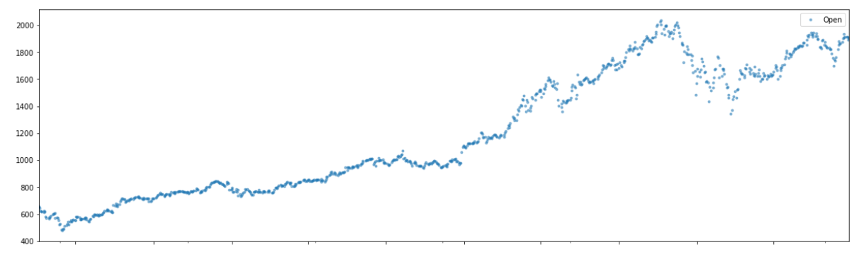
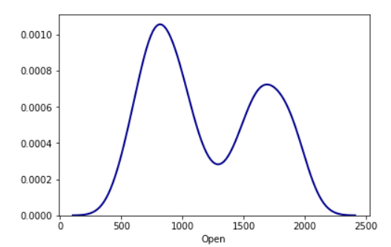
Exploratory Data Analysis

Slide 5
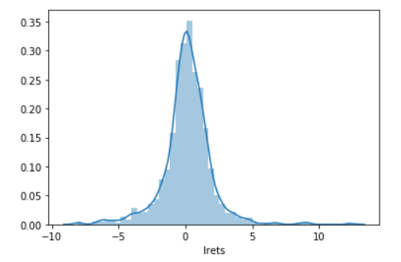
Distribution of returns

Slide 6
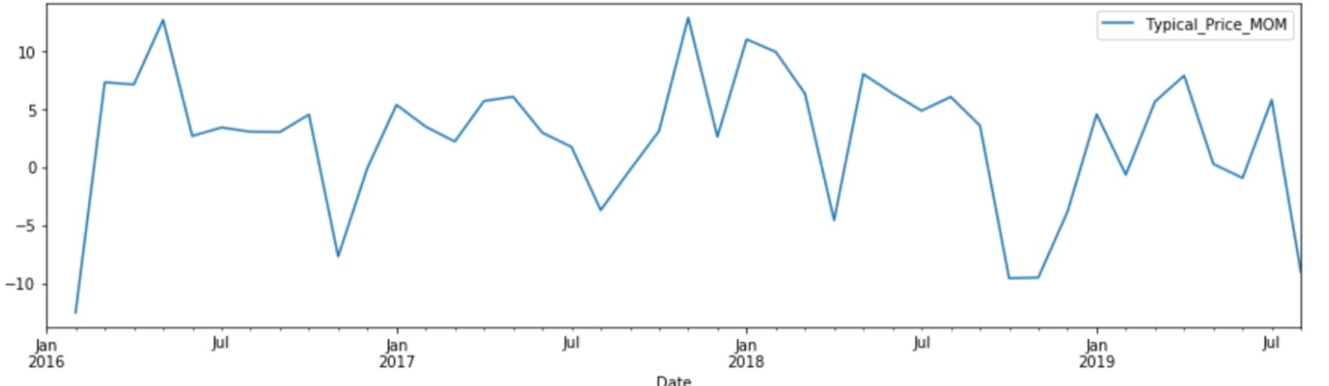
Monthly returns

Slide 7
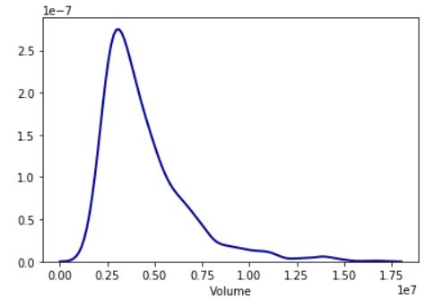
Volume Density plot

Slide 8
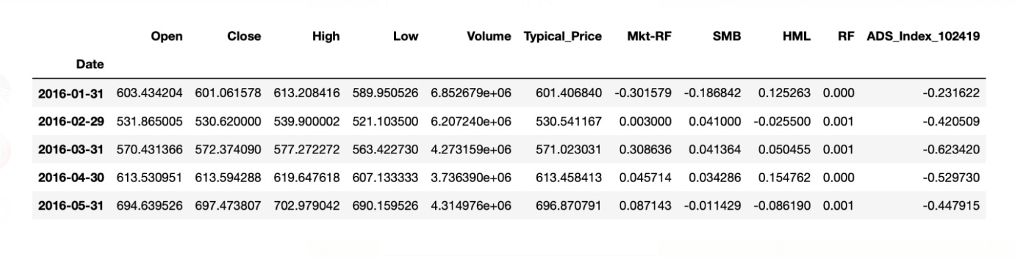
Data pre-processing

Slide 9
Candidate models
Kalman Filter
Moving Average
MIDAS
Keltner Chanel
Random Forest
GARCH
Model selection using Random forest

Slide 10
Trading Strategies
Buy and hold
- If prediction > yesterday’s close price -> buy;
- If already bought -> hold
- Else sell
Long and Short
- If predicted > yesterday’s close price -> go long else go short
Day trading
- If predicted > yesterday’s close price -> buy it at open and sell at close

Slide 11
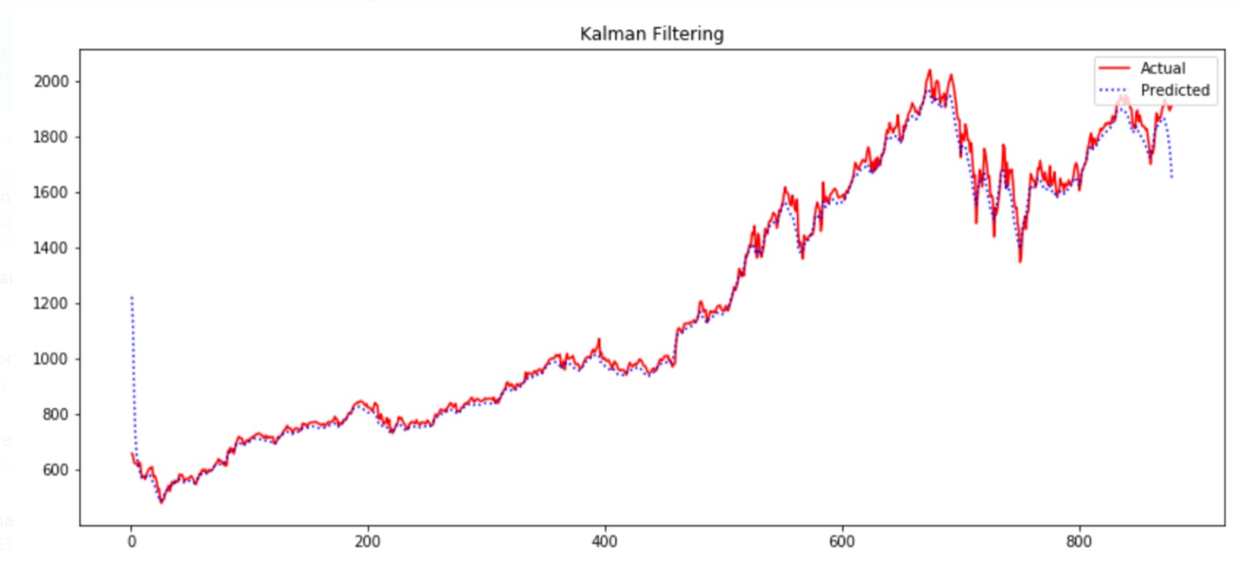
Kalman Filter

Slide 12
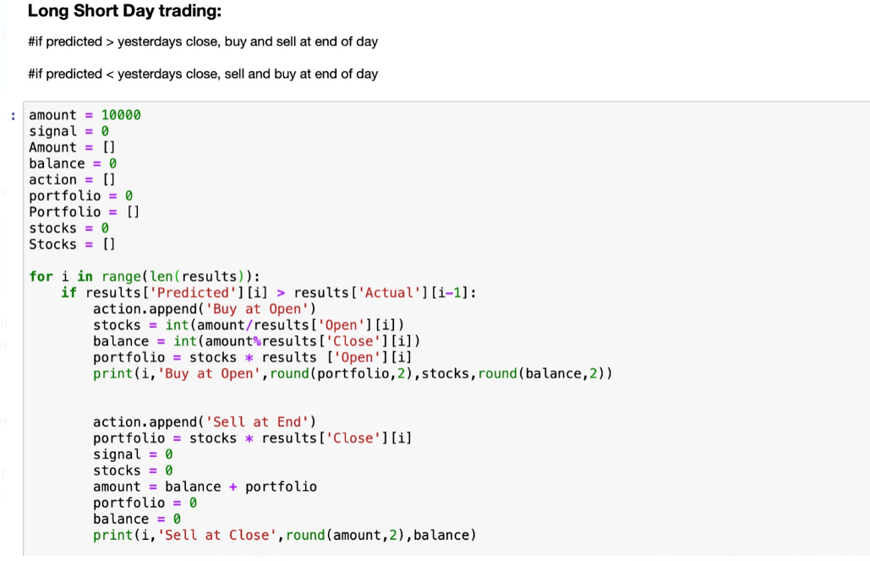
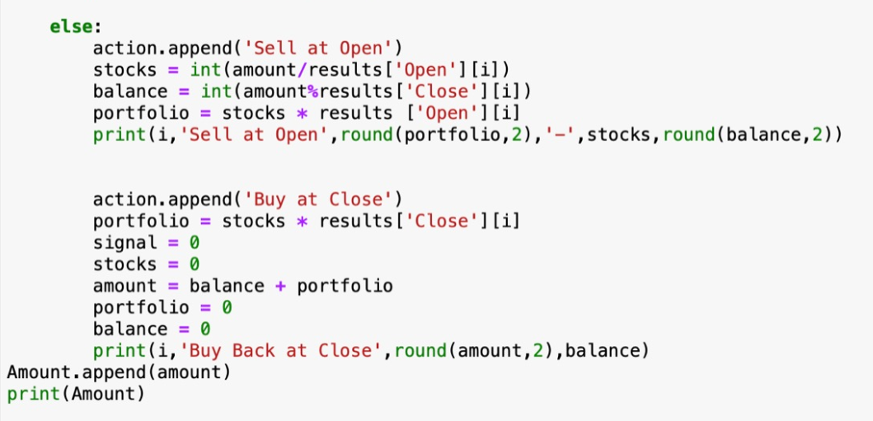
Strategy for Kalman Filter

Slide 13
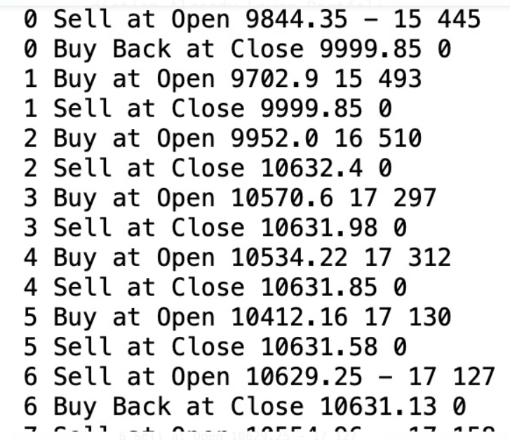
Back testing Result

Slide 14
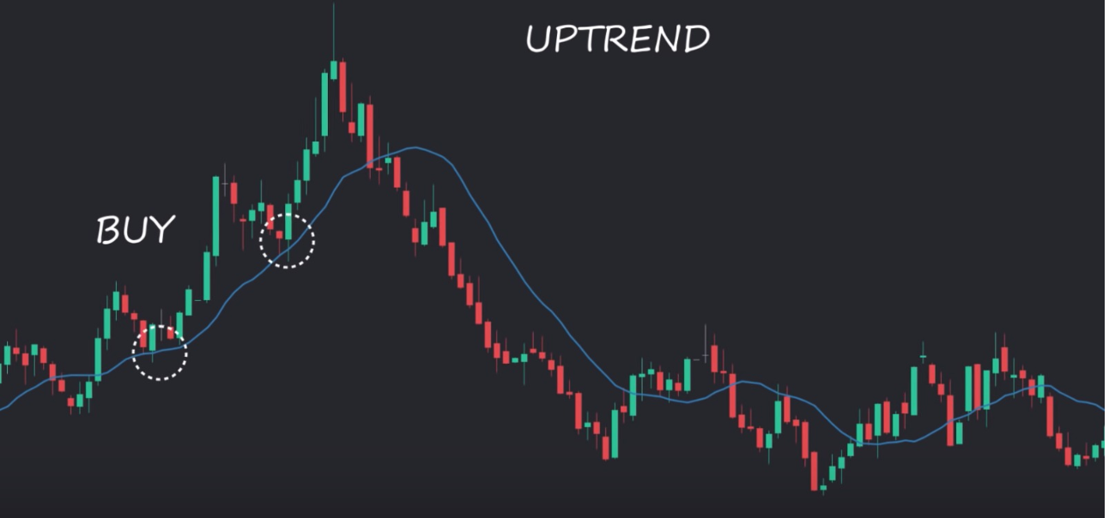
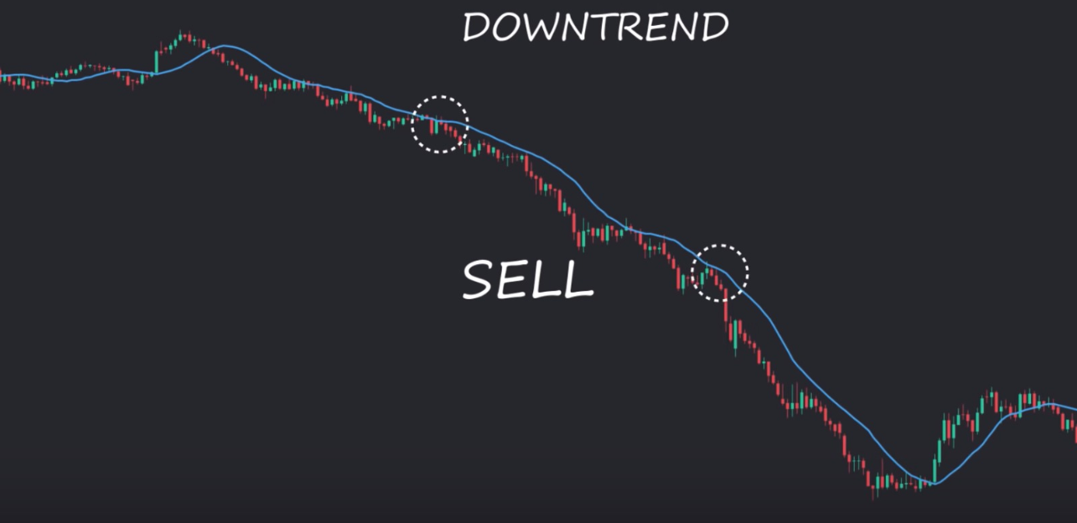
Moving Average
It is used indicator in technical analysis that helps smooth outprice action
Two basic and commonly used moving averages are simple moving average (SMA) and exponential moving average(EMA)

Slide 15
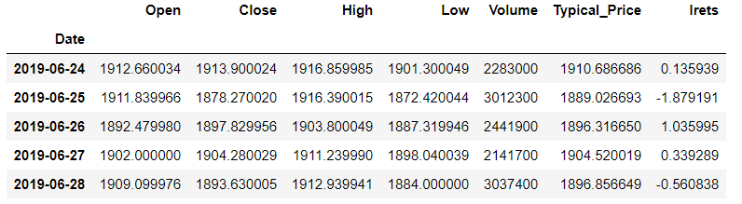
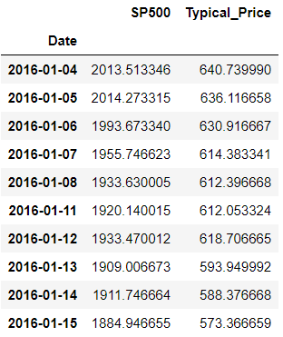
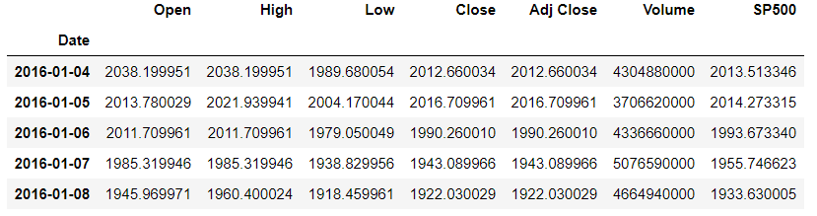
Combining data

Slide 16
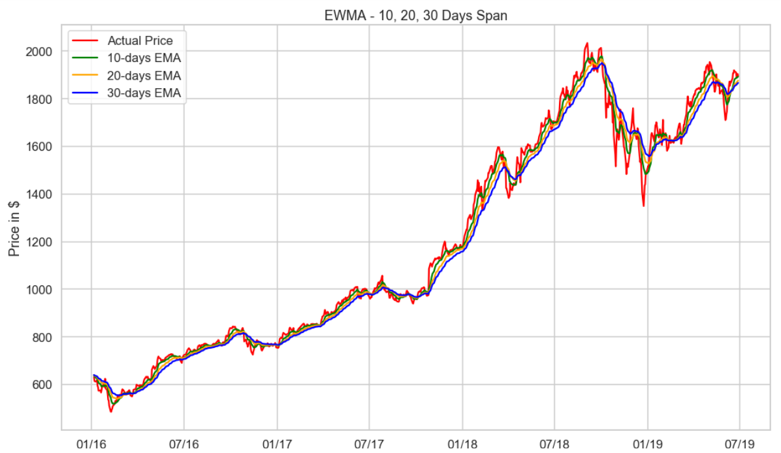
EMA for different time periods

Slide 17
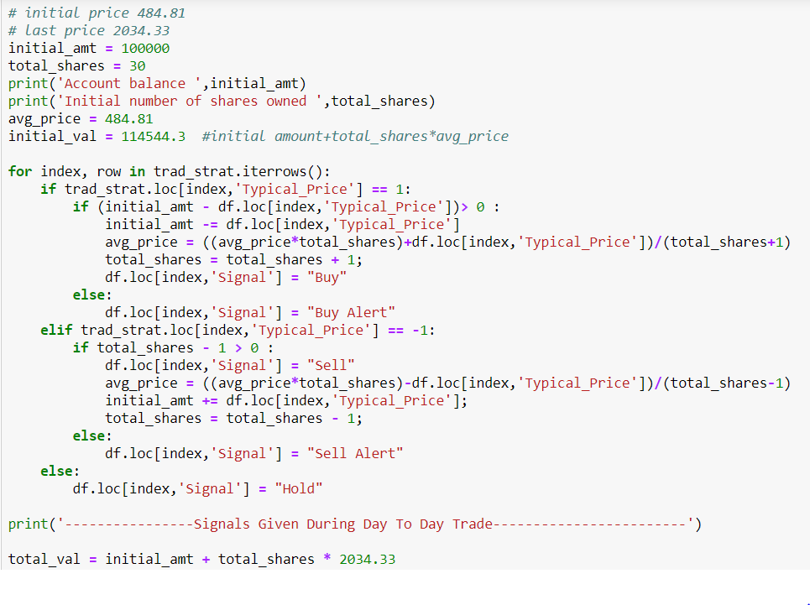
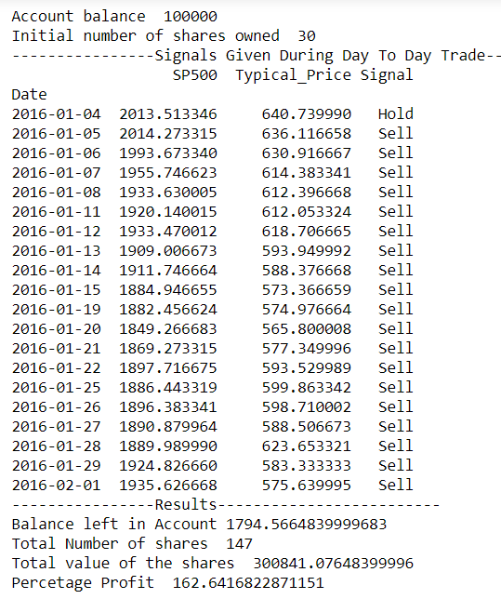
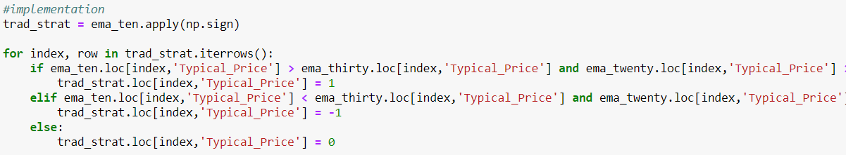
Trading Strategy for Moving Average

Slide 18
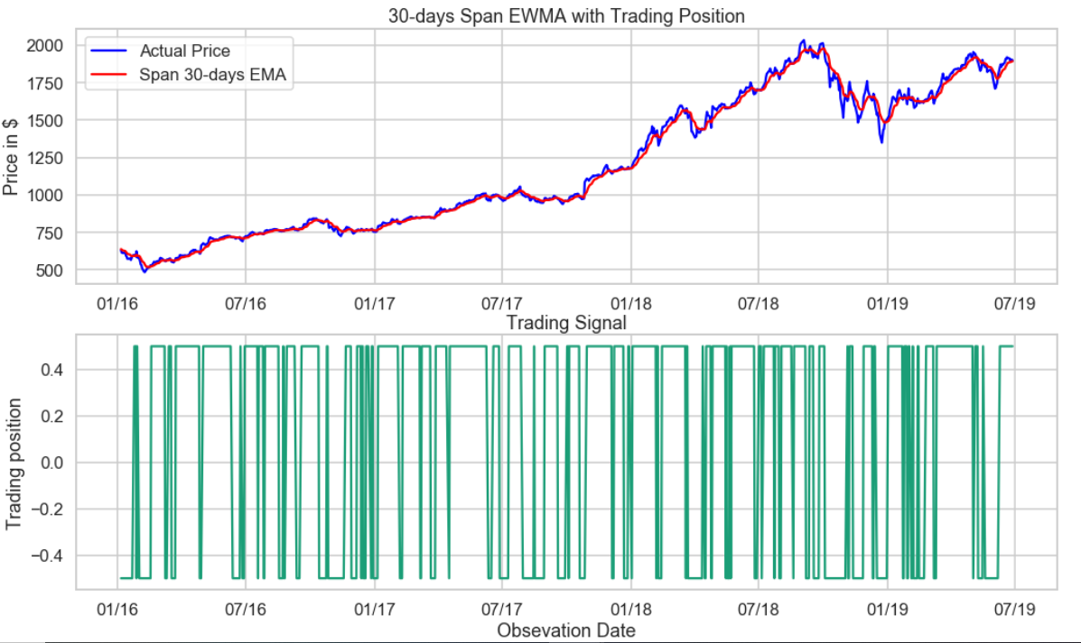
Trading position for 30 days

Slide 19
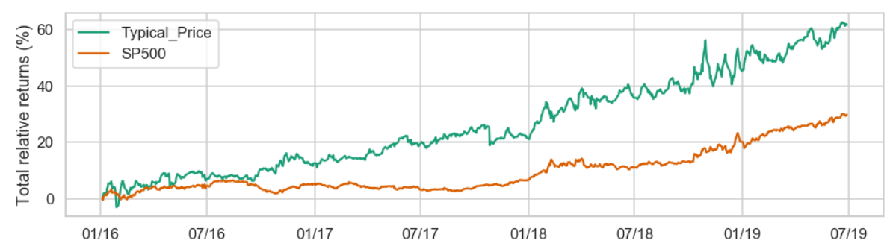
Relative returns

Slide 20
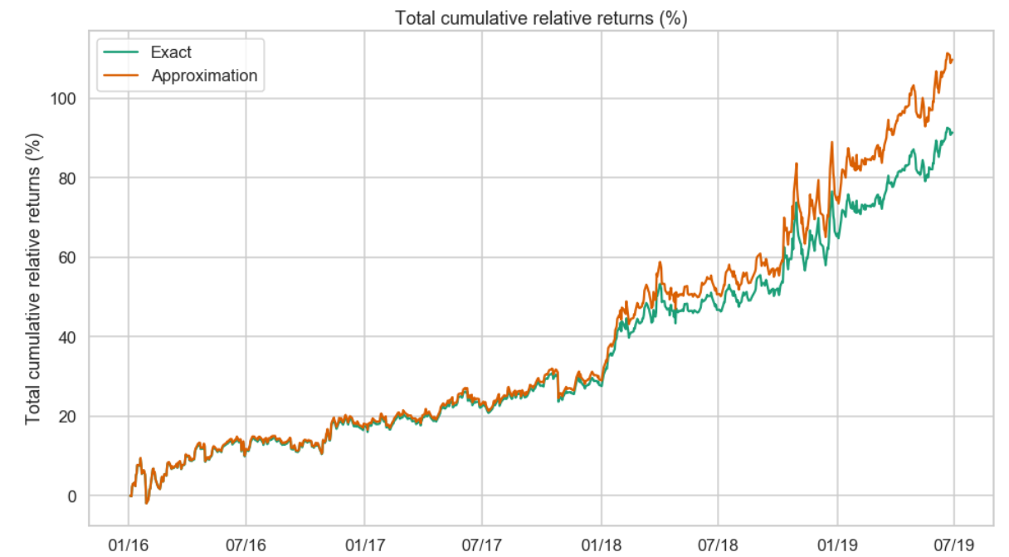
Cumulative Returns

Slide 21
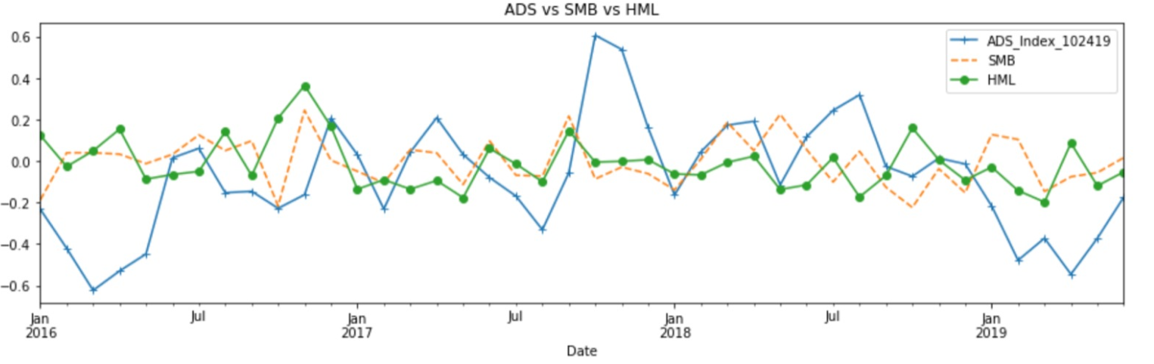
MIDAS

Slide 22
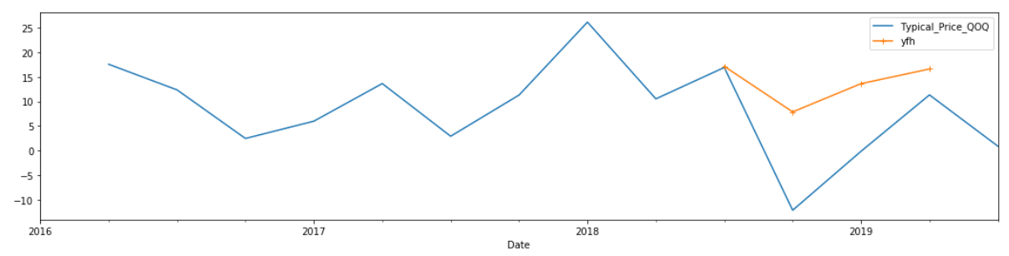
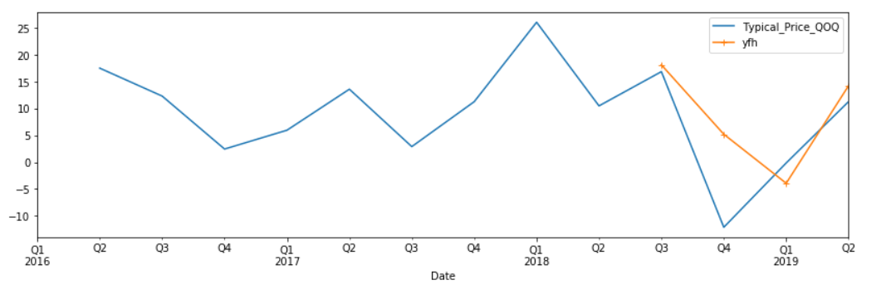
Trial Models
Lf = typical price mom
Hf = typical price qoq
Lf1 = typical price mom
Lf2 = volume mom
Hf = typical price qoq

Slide 23
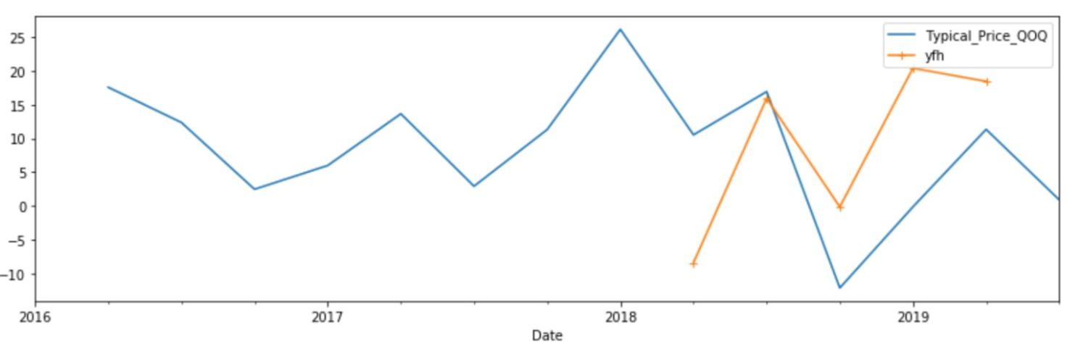
Final Model
Lf = typical price mom
Hf = typical price qoq
RMSE - $13.96 for log returns

Slide 24
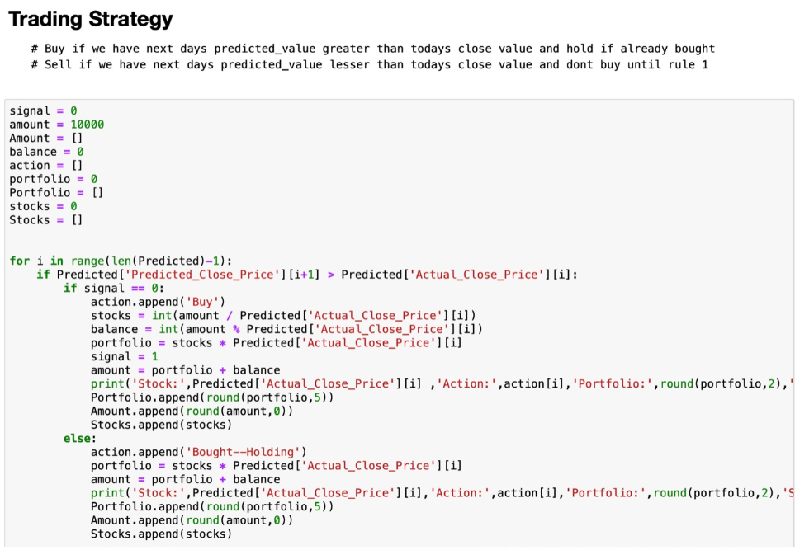
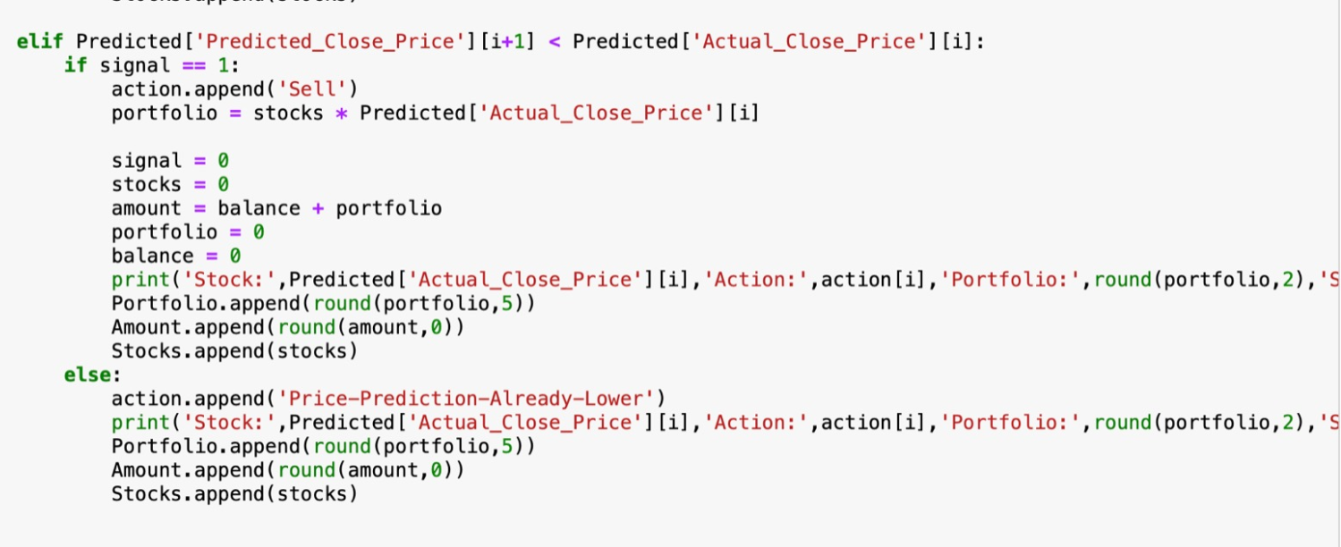
Strategy for MIDAS

Slide 25
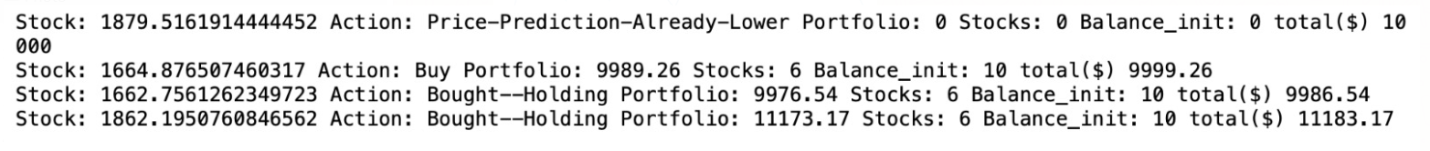
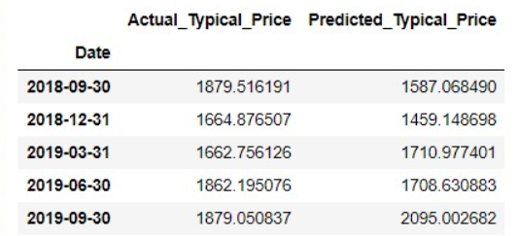
Quaterly Strategy Movement

Slide 26
Keltner Channel
A technical indicator which tells us the volatality of the market
ATR ( Highest of )
Current high - current low
Abs(current low) – previous close
Abs(current high) – previous close
Middle band = EMA
Upper band = EMA + 2(ATR)
Lower band = EMA – 2(ATR)

Slide 27
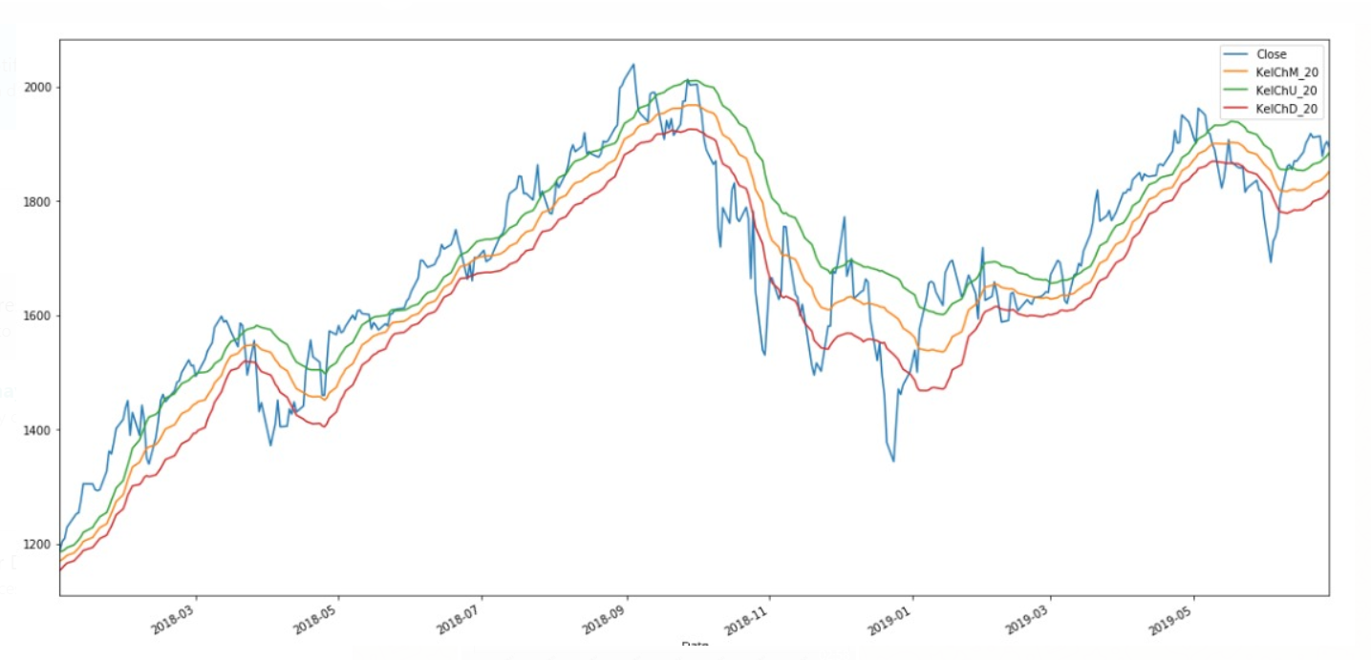
Keltner Channel

Slide 28
Random Forest
Random is a meta data estimator that fits number of classifying decision trees on various sub samples of dataset and uses averaging to improve the predictive accuracy
The basic idea is combining multiple decision trees in determining the final output rather than relying on individual decision trees.

Slide 29
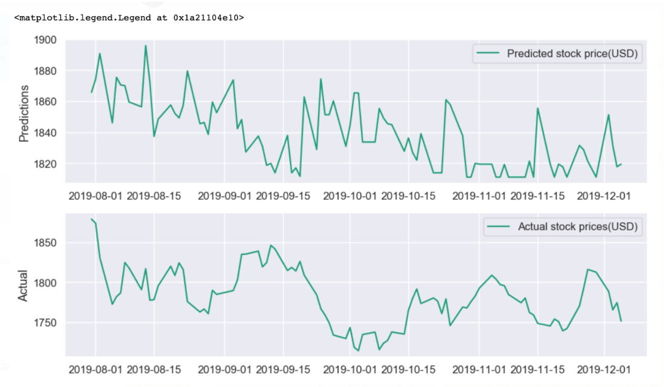
Comparing predicted and actual values for last 90 days

Slide 30
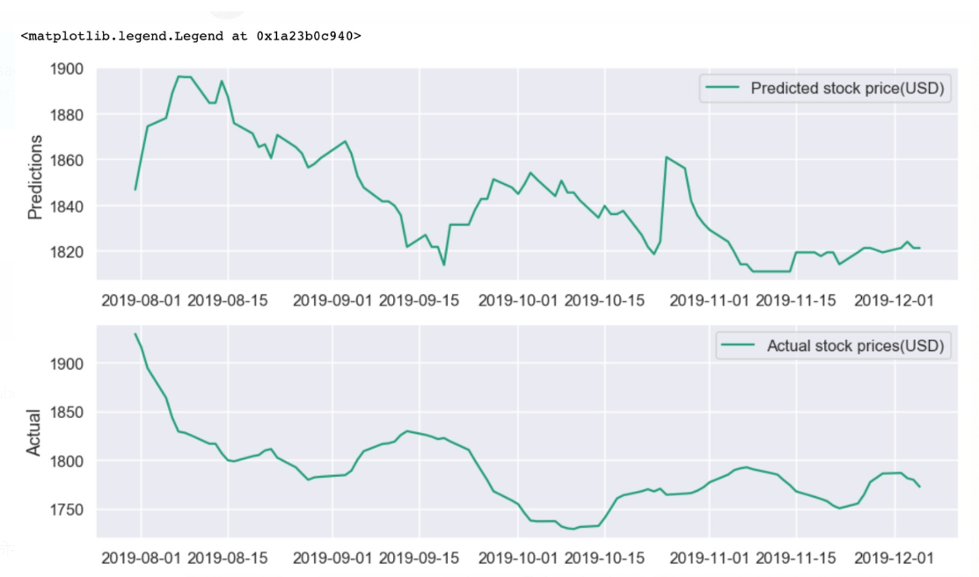
Comparison using Moving Average

Slide 31
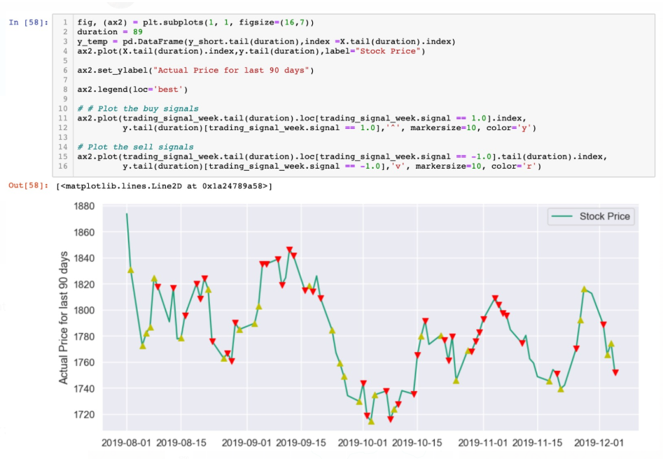
Trading signals

Slide 32
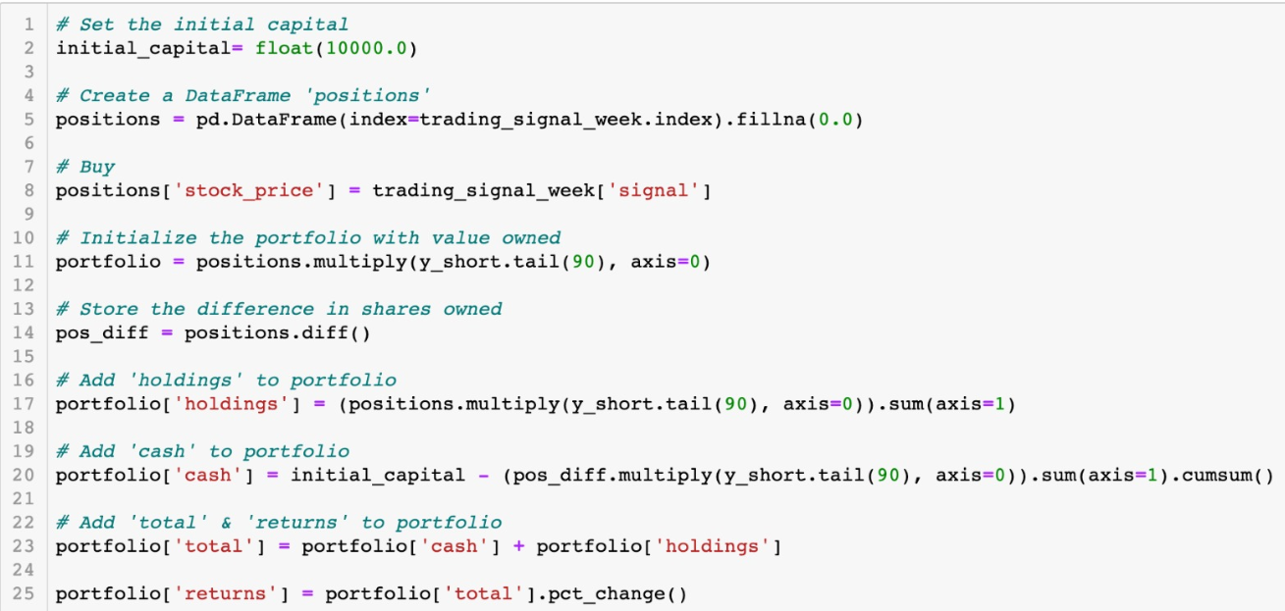
Trading Strategy

Slide 33
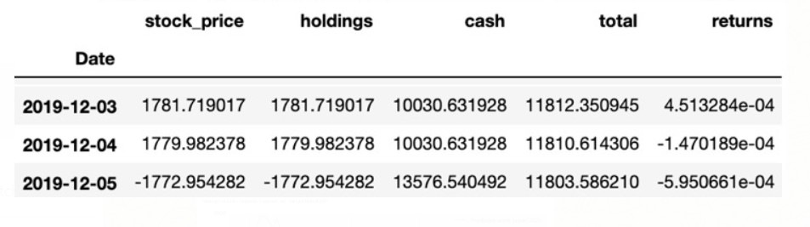
Returns

Slide 34
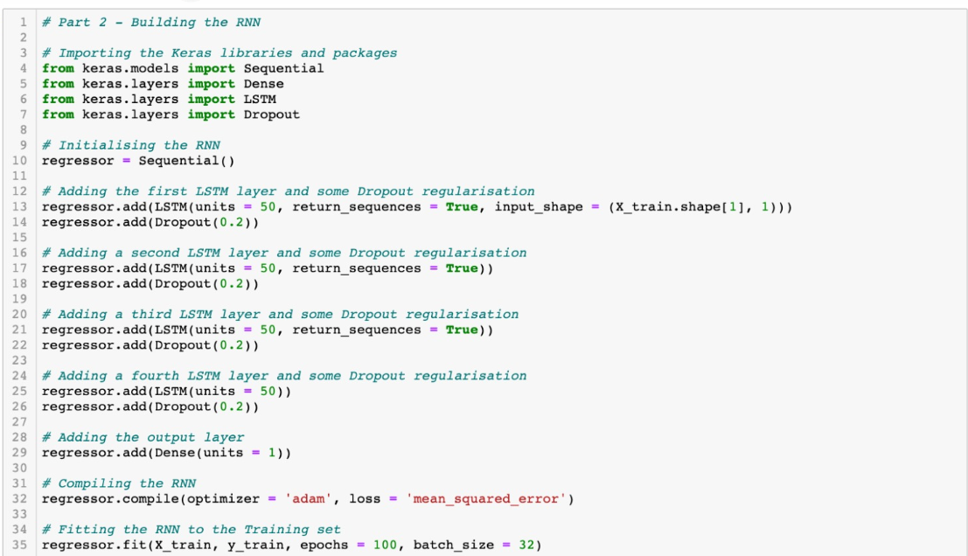
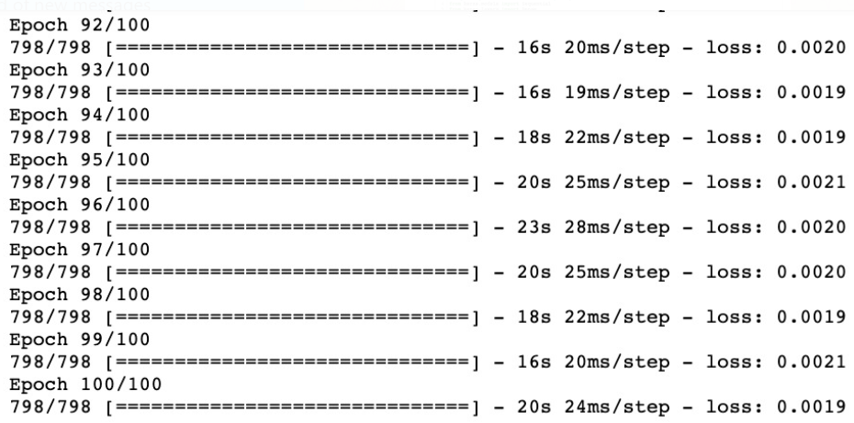
Time series prediction with LSTM

Slide 35
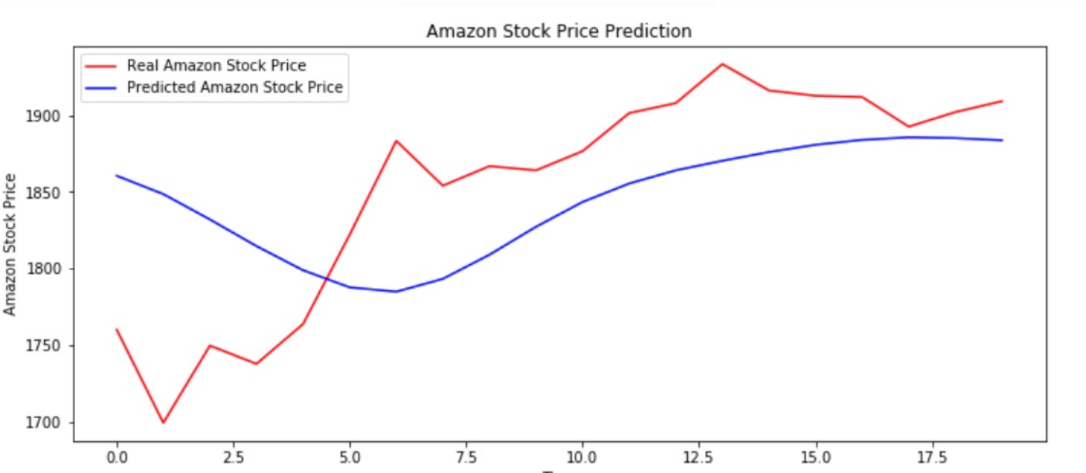
Comparison of actual v/s predicted

Slide 36
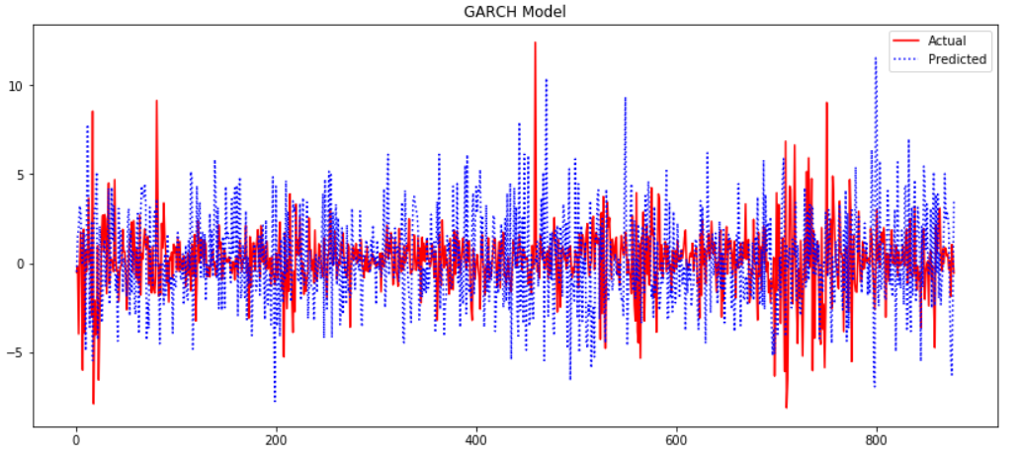
Garch
Minimized mean = 0.123
Standard Deviation = 1.88

Slide 37
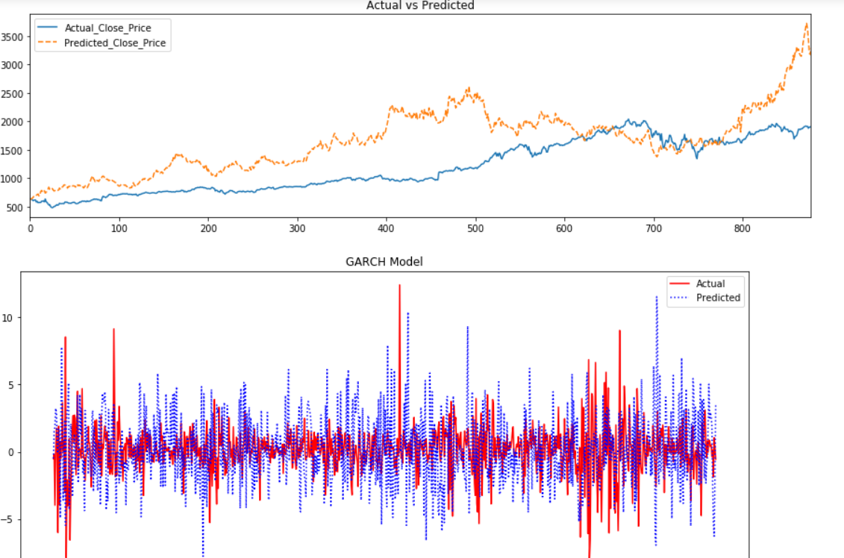
Volatility measure against prediction

Slide 38
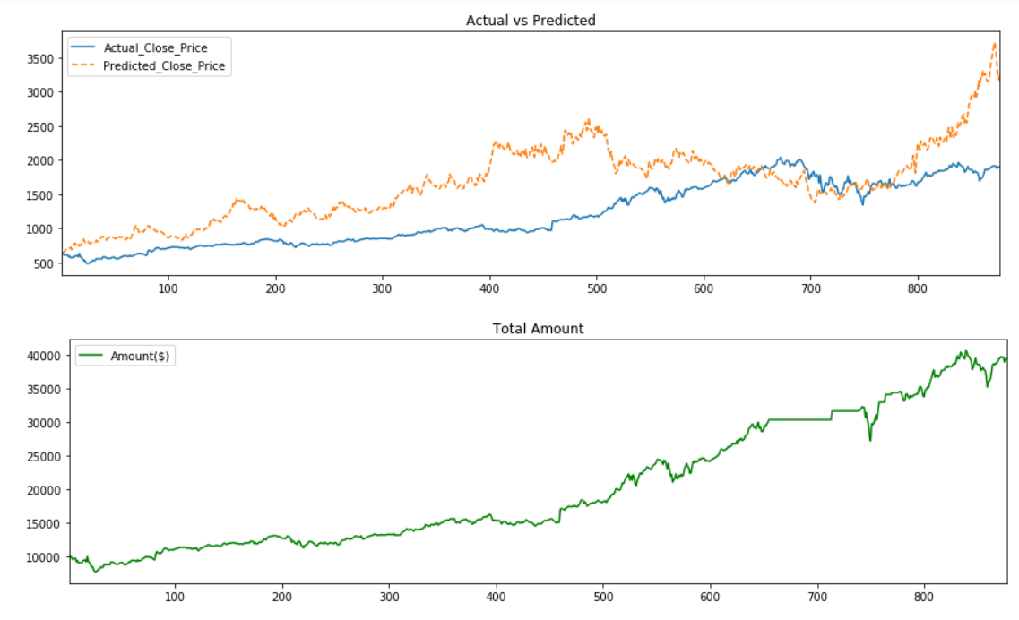
Portfolio Holdings

Slide 39
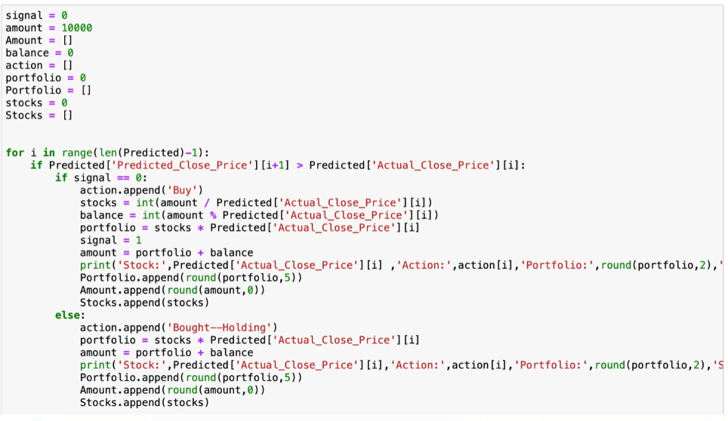
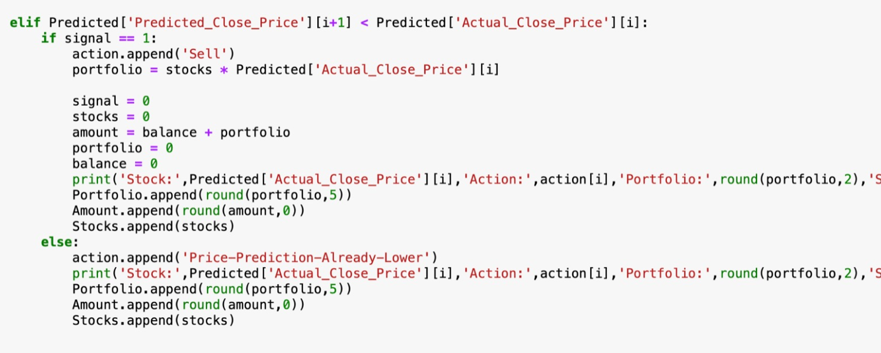
Trading Strategy for GARCH

Slide 40
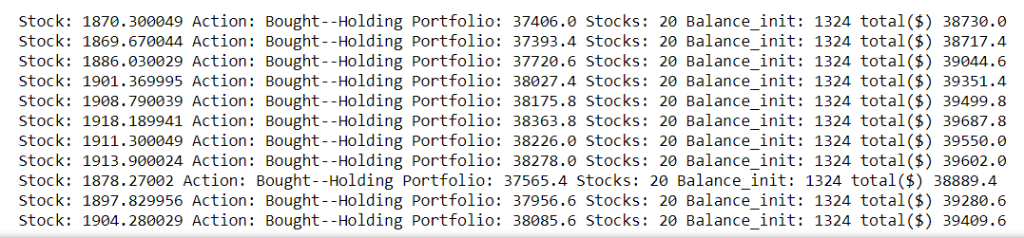
Daily strategy movements

Slide 41
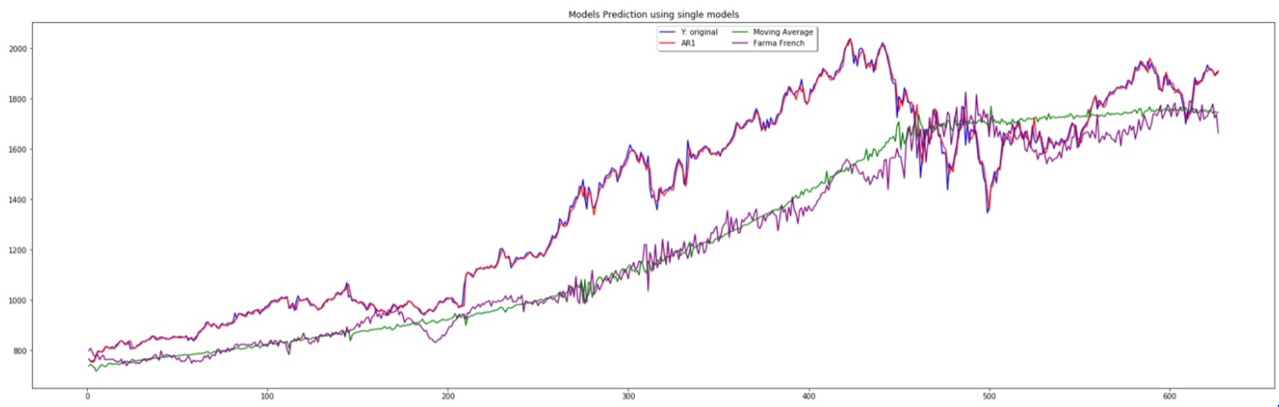
Model selection using Random Forest

Slide 42
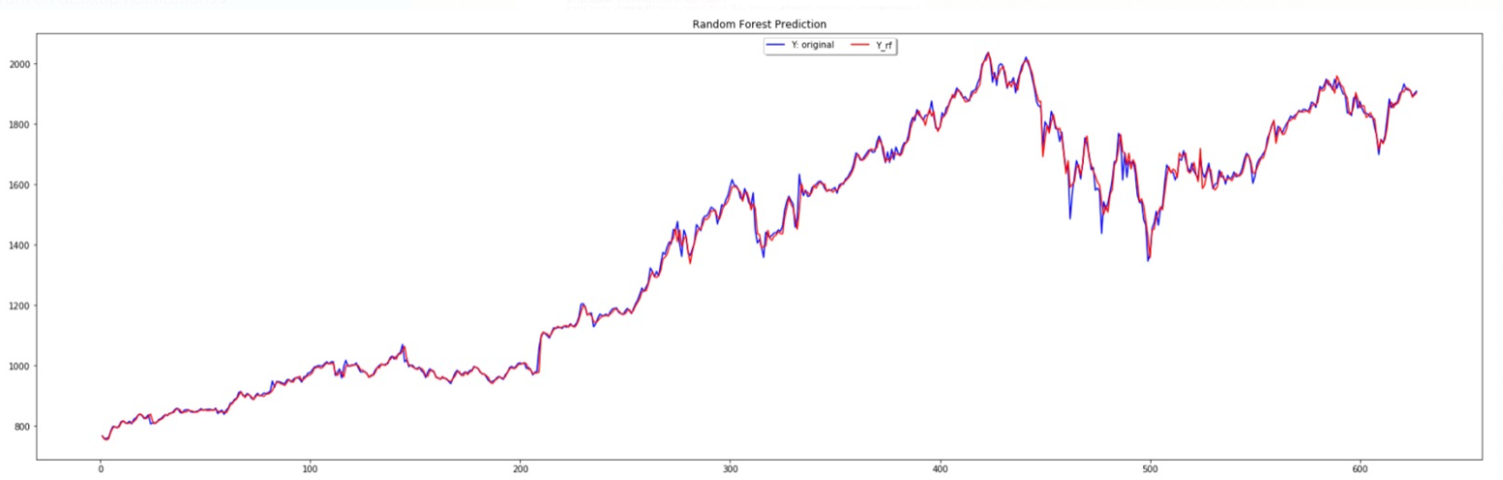
Random Forest prediction

Slide 43
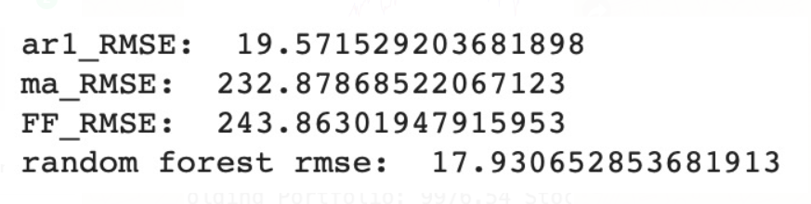
RMSE for Random Forest

Slide 44
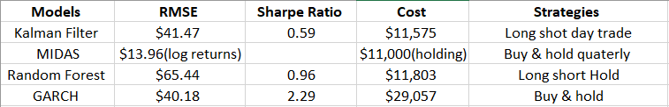
Performance Evaluation

